Slide 1
Welcome to Curriculum Night 6th Grade Tennille Farias Becky From Christa Lutz Daphne Medina Clare Olivares Tori Rupa

Slide 2
Coming to School
No earlier than 8:15 a.m.
Closed campus
Soft Start – students go directly to their classrooms

Slide 3
Sixth Grade Goals
Prepare for Junior High
Academically
Socially
Using 21st century skills
Kindness
Project Be Kind
Pay it forward

Slide 4
Social Emotional Learning (SEL)
Second Step Curriculum
Teaches various topics:
Thoughts, emotions, decisions
Mindsets and goals
Values and friendships

Slide 5
Reading
We read a lot!
My Perspectives texts
Literature studies
Scholastic News
Informational texts
Science/Social Studies
Independent reading/ AR
Read-aloud
To practice skills:
Comprehension
Vocabulary development
Annotation

Slide 6
Writing
We also write a lot!
Cite textual evidence
Organize with Thinking Maps
Graded using AASA Rubric
Mechanics and grammar
Variety of genres
Narrative
Argumentative essay
Response to Literature
Expository essay
Research reports

Slide 7
AASA Writing Rubric
Statement of Purpose/
Focus and Organization __/4
Evidence/Elaboration __/4
Conventions/Editing __/2
Total __/10

Slide 8
Classic Math
Glencoe Text, Course 1
Skills reinforced through homework and class work
Mental math/problem solving/real-world application
Nightly math homework
Fast facts – 100 problems in 3 minutes
www.xtramath.org

Slide 9
CTA Math

Slide 10
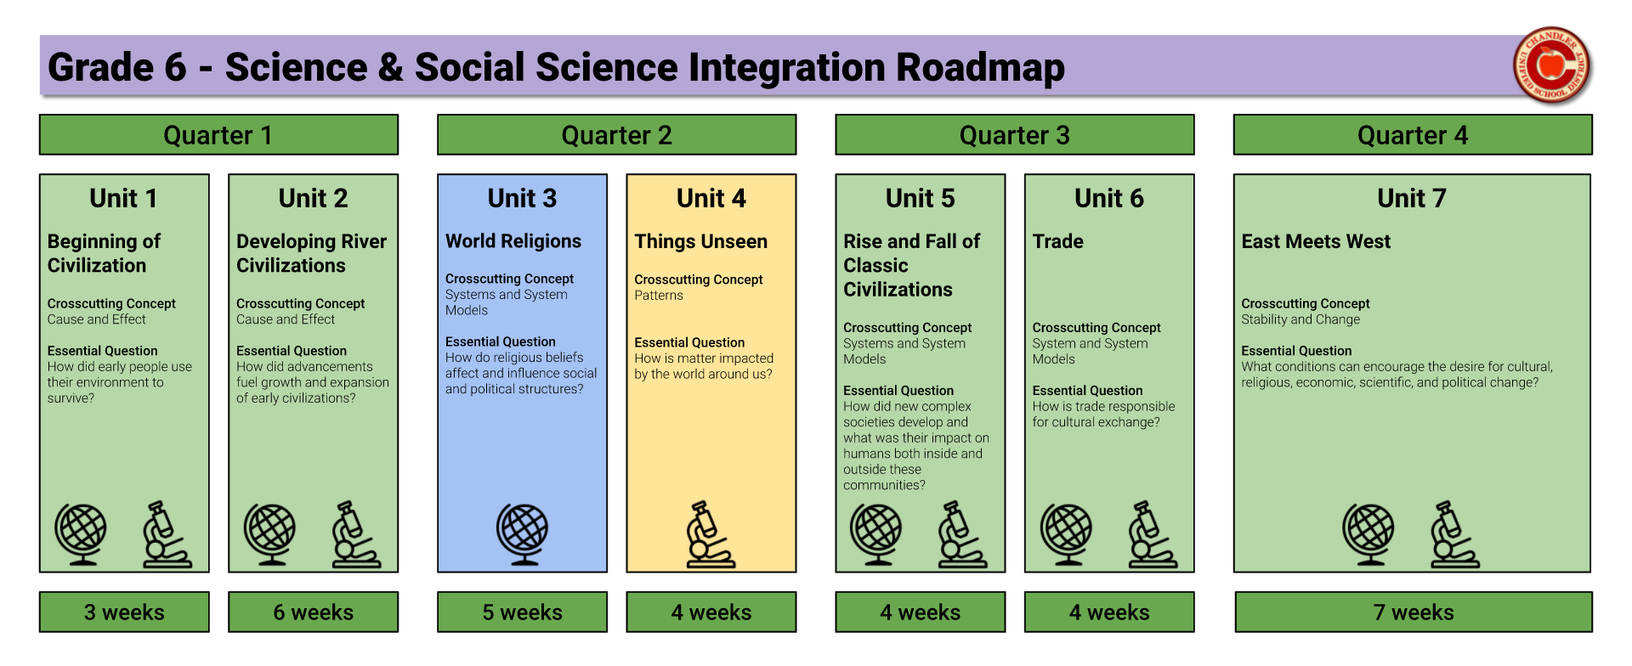

Slide 11
Homework and Classroom Expectations
Homework is due in the morning
20-30 minutes of daily reading at home is expected
PRIDE cards
Infinite Campus – Please update your info and check weekly
Teacher updates via newsletter/email
Devices/cell phones/smart watches

Slide 12
Fun!
STEM Activities
Egypt Day
Pay it Forward
PRIDE PARTIES
Basha Pool
Science Camp

Slide 13
Science Camp
YES! Science Camp is on the calendar this year!
Aspen Creek – Prescott
Dates – May 8-10, 2024
Cost - $150 (approximate)
Parent Meeting TBD
Behavior expectations

Slide 14
Healthy Students are Better Students
Students who eat healthy are more attentive, have a stronger memory, learn easier, and are in better moods.
Some healthy foods include: cheese, nuts, whole grains, yogurt, fruit, vegetables, and hard boiled eggs.

Slide 18
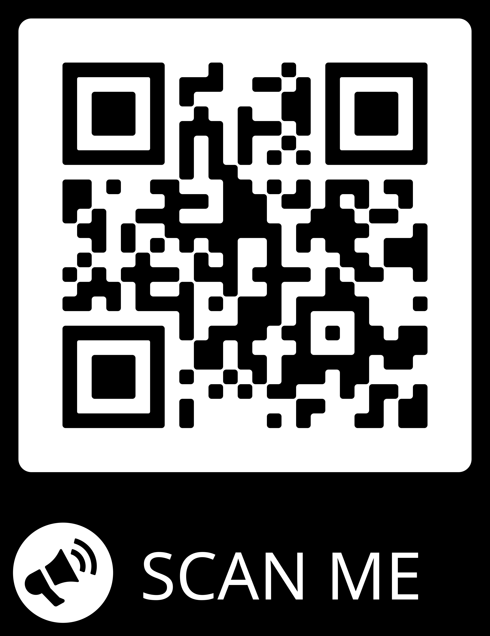

Slide 19
Thank you for your support!
Look for emails for class updates and events.
Please contact us first with questions or concerns.
We are a team!

